Slide 1
LECTURE 2:
PHP FUNCTIONS
Arafat Hassan

Slide 2
WHY FUNCTIONS?
We have already seen that PHP has lots of built-in functions that we use all the time.
We write our own functions when our code reaches a certain level of complexity.

Slide 3
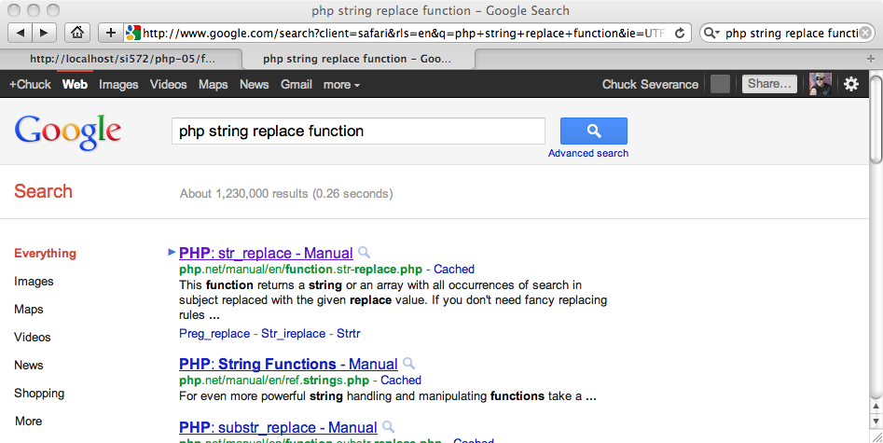
PHP DOCUMENTATION - GOOGLE

Slide 4
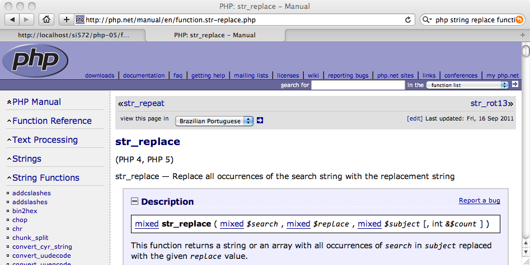
PHP DOCUMENTATION - GOOGLE

Slide 5
BUILT-IN FUNCTIONS...
Much of the power of PHP comes from its built-in functions.
Many are modeled after C string library functions (i.e. strlen()).
echo strrev(" .dlrow olleH"); echo str_repeat("Hip ", 2); echo strtoupper("hooray!");
echo strlen("intro");
echo "\n";
Hello world.
Hip Hip
HOORAY!
5

Slide 6
User defined functions

Slide 7
TO FUNCTION OR NOT TO FUNCTION...
Organize your code into “paragraphs” - capture a complete thought and “name it”.
Don’t repeat yourself - make it work once and then reuse it.
If something gets too long or complex, break up logical chunks and put those chunks in functions.
Make a library of common stuff that you do over and over - perhaps share this with your friends...

Slide 8
DEFINING YOUR OWN FUNCTIONS
We use the function keyword to define a function, we name the function and take optional argument variables. The body of the function is in a block of code { }
function greet() {
print "Hello\n";
}
greet();
greet();
Hello
Hello

Slide 9
CHOOSING FUNCTION NAMES
Much like variable names - but do not start with a dollar sign
Start with a letter or underscore - consist of letters, numbers, and underscores ( _ )
Avoid built-in function names
Case does not matter – but please do not take advantage of this

Slide 10
RETURN VALUES
Often a function will take its arguments, do some computation, and return a value to be used as the value of the function call in the calling expression. The return keyword is used for this.
function greeting() {
return "Hello";
}
print greeting() . " Glenn\n";
print greeting() . " Sally\n";
Hello Glenn
Hello Sally

Slide 11
ARGUMENTS
Functions can choose to accept optional arguments. Within the function definition the variable names are effectively “aliases” to the values passed in when the function is called.
function howdy($lang) {
if ( $lang == 'es' ) return "Hola";
if ( $lang == 'fr' ) return "Bonjour";
return "Hello";
}
print howdy('es') . " Glenn\n";
print howdy('fr') . " Sally\n";
Hola Glenn
Bonjour Sally

Slide 12
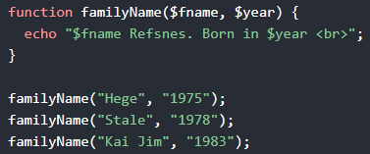
ARGUMENTS
The following example has a function with two arguments ($fname and $year):

Slide 13
OPTIONAL ARGUMENTS
Arguments can have defaults, and so can be omitted.
function howdy($lang='es') {
if ( $lang == 'es' ) return "Hola";
if ( $lang == 'fr' ) return "Bonjour";
return "Hello";
}
print howdy() . " Glenn\n";
print howdy('fr') . " Sally\n";
Hola Glenn
Bonjour Sally

Slide 14
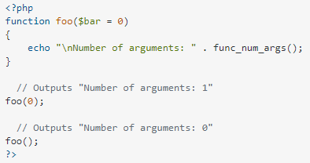
OPTIONAL ARGUMENTS
You can find out how many arguments were passed in like this -

Slide 15
CALL BY VALUE
The argument variable within the function is an “alias” to the actual variable.
But even further, the alias is to a *copy* of the actual variable in the function call.
function double($alias) {
$alias = $alias * 2;
return $alias;
}
$val = 10;
$dval = double($val);
echo "Value = $val Doubled = $dval\n";
Value = 10 Doubled = 20

Slide 16
CALL BY REFERENCE
Sometimes we want a function to change one of its arguments, so we indicate that an argument is “by reference” using ( & ).
function triple(&$realThing) {
$realThing = $realThing * 3;
}
$val = 10;
triple($val);
echo "Triple = $val\n";
Triple = 30

Slide 17
SCOPE AND MODULARITY

Slide 18
VARIABLE SCOPE
In general, variable names used inside of function code do not mix with the variables outside of the function to avoid unexpected side effects if two programmers use the same variable name in different parts of the code.
We call this “name spacing” the variables. The function variables are in one “name space” whilst the main variables are in another “name space”.
http://php.net/manual/en/language.variables.scope.php

Slide 19
NORMAL SCOPE (ISOLATED)
function tryzap() {
$val = 100;
}
$val = 10;
tryzap();
echo "TryZap = $val\n";
TryZap = 10
http://php.net/manual/en/language.variables.superglobals.php

Slide 20
GLOBAL SCOPE (SHARED)
function dozap() {
global $val;
$val = 100;
}
$val = 10;
dozap();
echo "DoZap = $val\n";
DoZap = 100
Use this wisely, young Jedi...

Slide 21
GLOBAL VARIABLES – USE RARELY
Passing variable in as parameter
Passing value back as return value
Passing variable in by reference
If you use global variables, use long names with nice unique prefixes
global $LastOAuthBodyBaseString;
global $LAST_OAUTH_BODY_BASE_STRING;

Slide 22
COPING WITH MISSING BITS
Sometimes, depending on the version or configuration of a particular PHP instance, some functions may be missing. We can check that...
if (function_exists("array_combine")){
echo "Function exists";
} else {
echo "Function does not exist";
}
This allows for evolution.

Slide 23
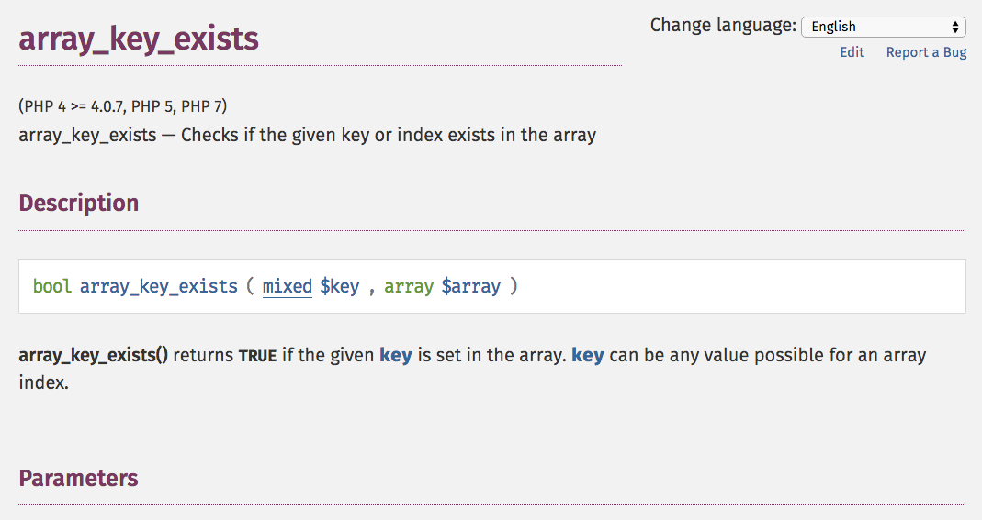
http://php.net/manual/en/function.array-key-exists.php

Slide 24
ONE HECK OF A FUNCTION…
PHP is a very configurable system and has lots of capabilities that can be plugged in.
The phpinfo() function prints out the internal configuration capabilities of your particular PHP installation,
<?php
phpinfo();
?>

Slide 25
Arrow Function

Slide 26
Arrow Functions
The fn keyword is used to create arrow functions. Arrow functions are only available in PHP versions 7.4 and up.
Arrow functions have access to all variables from the scope in which they were created.
The general syntax of an arrow function is:

Slide 27
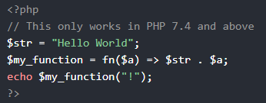
Arrow Functions
For example,

Slide 28
Call Stack

Slide 29
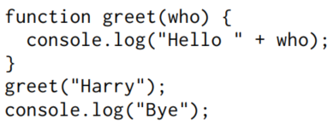
The Call Stack
Here is a simple program that makes a few function calls:
The call to greet function causes control to jump to the start of that function (line 2).
The function calls console .log, which takes control, does its job, and then returns control to line 2.

Slide 30
The Call Stack
Then, it reaches the end of the greet function, so it returns to the place that called it, which is line 4.
The line after that calls console.log again. After that returns, the program reaches its end

Slide 31
The Call Stack
Because a function has to jump back to the place that called it when it returns, the computer must remember the context from which the call happened.
The place where the computer stores this context is the call stack.
Storing this stack requires space in the computer’s memory. When the stack grows too big, the computer will fail with a message complaining of running out of stack space.
The following code illustrates this by asking the computer a really hard question that causes an infinite back-and-forth between two functions.

Slide 32
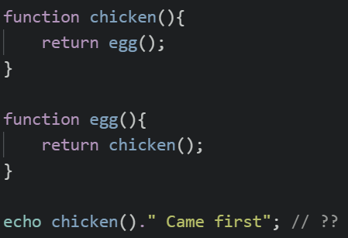
The Call Stack

Slide 33
Recursion

Slide 34
Recursion
It is perfectly okay for a function to call itself, as long as it doesn’t do it so often that it overflows the stack.
A function that calls itself is called recursive.
Recursion allows some functions to be written in a different style.
Take, for example, this alternative implementation of power:

Slide 35
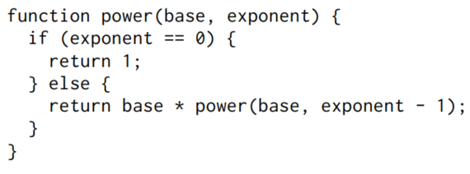
Recursion
Can you implement the same code using loops rather than recursion?

Slide 36
Recursion
Recursive methods are often slower than the same implementation using loops. But they are much easier to understand and implement as well.
It is up to the programmer to find a balance between efficiency and elegancy.
For example, calculating the power using loops is still easy and understandable. So probably loops are more appropriate for this.
But recursion may be more appropriate in other more complex algorithms.

Slide 37
Challenges

Slide 38
Challenges
Implement a function that finds the minimum of two numbers.
Now, use the previous function to implement a function that finds the minimum of three numbers
Now use these two functions and your knowledge of optional parameter to implement a function that finds the minimum of either two or three numbers

Slide 39
Challenges
Implement a function that takes in two arguments. n and a. Both arguments are integers.
It returns the integer in 10^a-th place of n. For example,
n = 1541, a = 2. Return the digit in 10^2 (100th) place. Ans: 5.
n = 415, a =1. Return the digit in 10^1 (10th) place. Ans: 1.
n = 7474, a = 0. Return the digit in 10^0 (units) place. Ans: 4.

Slide 40
Challenges
We’ve seen that % (the remainder operator) can be used to test whether a number is even or odd by using % 2 to see whether it’s divisible by two.
Here’s another way to define whether a positive whole number is even or odd ->

Slide 41
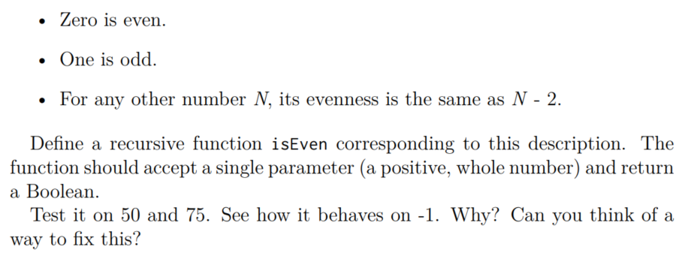
Challenges
Here’s another way to define whether a positive whole number is even or odd:

Slide 42
Challenges
Implement a function that can find the nth term of this series -
2, 6, 14, 26, 42 ….
Implement a function that can find the nth term of this series -
1, 2, 6, 24, 120, 720 …
Implement a function that can find the nth term of the Fibonacci series -
1, 1, 2, 3, 5, 8, 13 …
Implement a function that can find the HCF of two numbers
Implement a function that can find the LCM of two numbers

Slide 43
Challenges
Input three number - x, a, b. Then print the multiplication table of x starting from a and ending at b.
The program does not end after than. It asks for more input so that it can print another multiplication table.
The program only ends when an invalid number is entered for any of the three inputs. An error message is printed before the program ends.

Slide 44
Challenges
Input four number - x, y, a, b. Then print the multiplication tables of all integers from x to y inclusive, starting from a and ending at b.
Multiplication tables will be separated by two line breaks (“\n”)
The program does not end after than. It asks for more input so that it can print more multiplication tables.
The program only ends when an invalid number is entered for any of the three inputs. An error message is printed before the program ends.

Slide 45
Challenges
Sample input - 1, 3, 1, 2
Output -
1 * 1 = 1
1* 2 = 2
2 * 1 = 2
2 * 2 = 4
3 * 1 = 3
3* 2 = 6

Slide 46
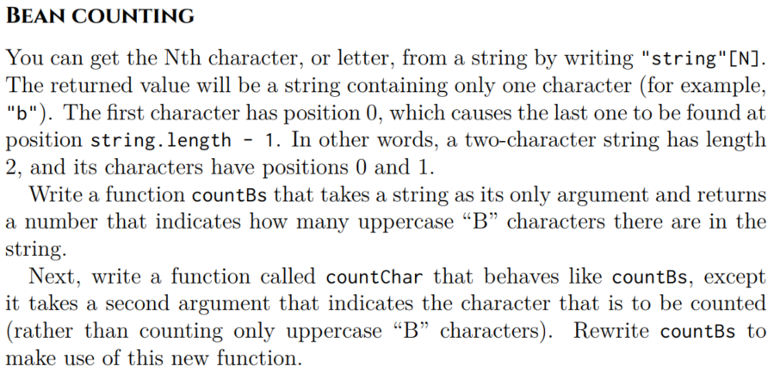
Challenges

Slide 47
Some more problems
https://leetcode.com/problems/reverse-integer/
https://leetcode.com/problems/count-of-matches-in-tournament/
https://leetcode.com/problems/maximum-69-number/

Slide 48
Thank you

